Slide 1

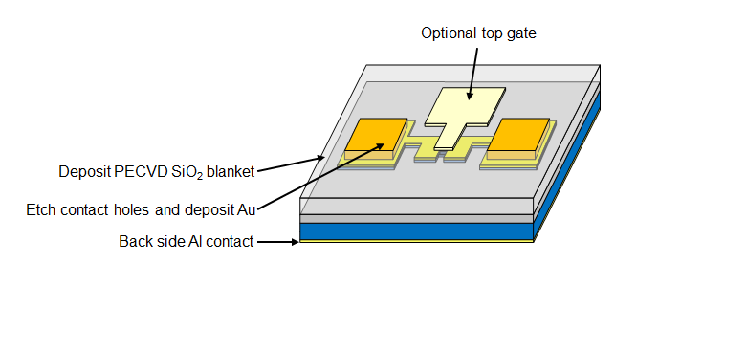
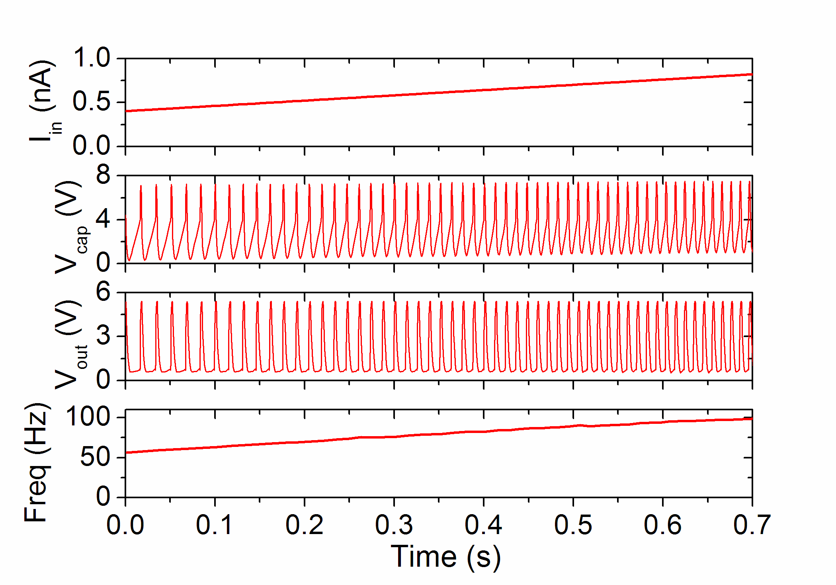
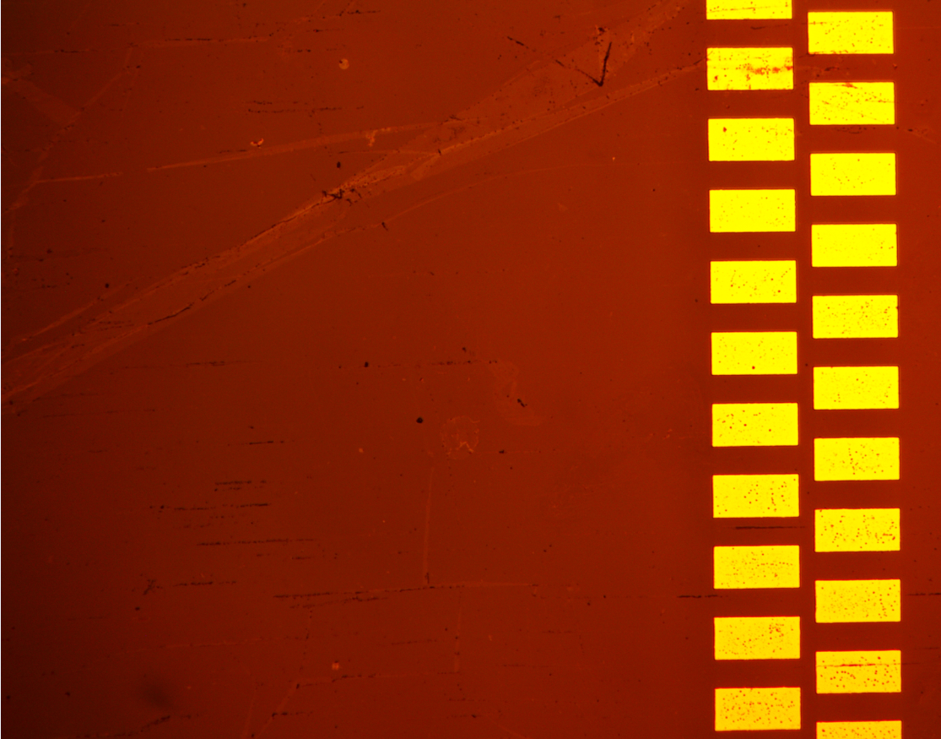
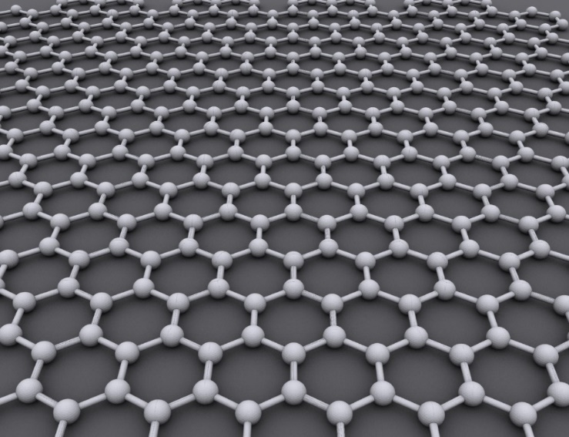
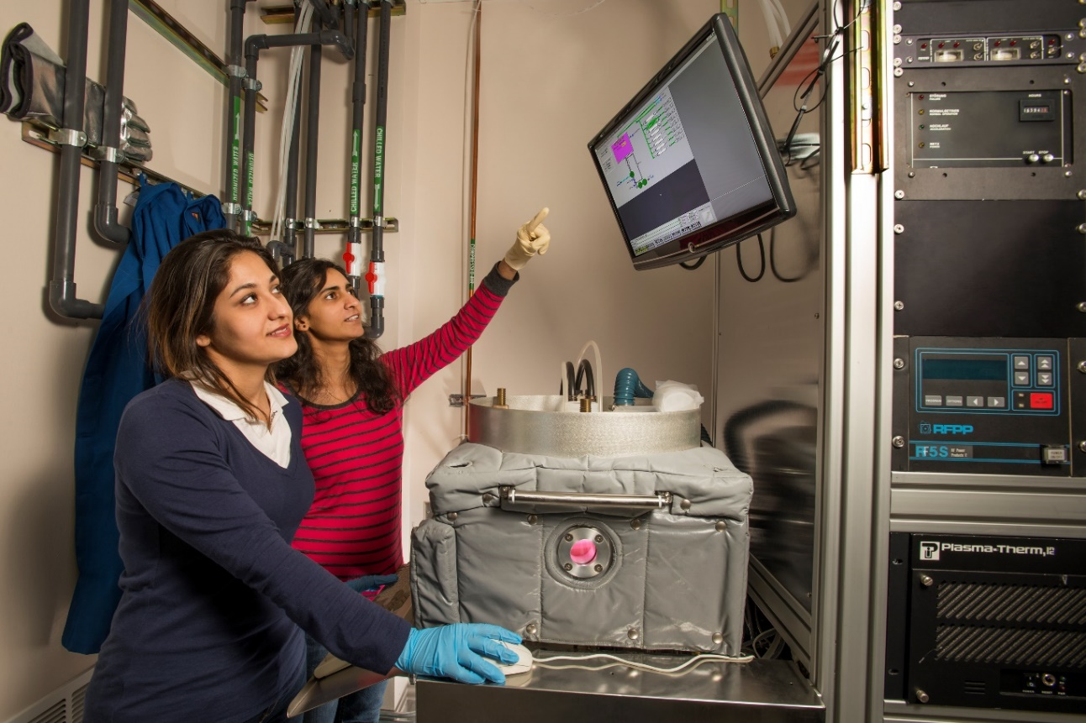
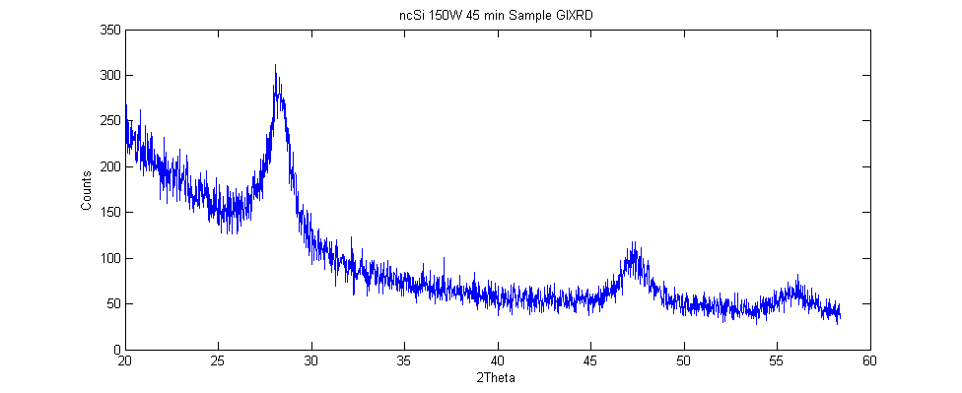
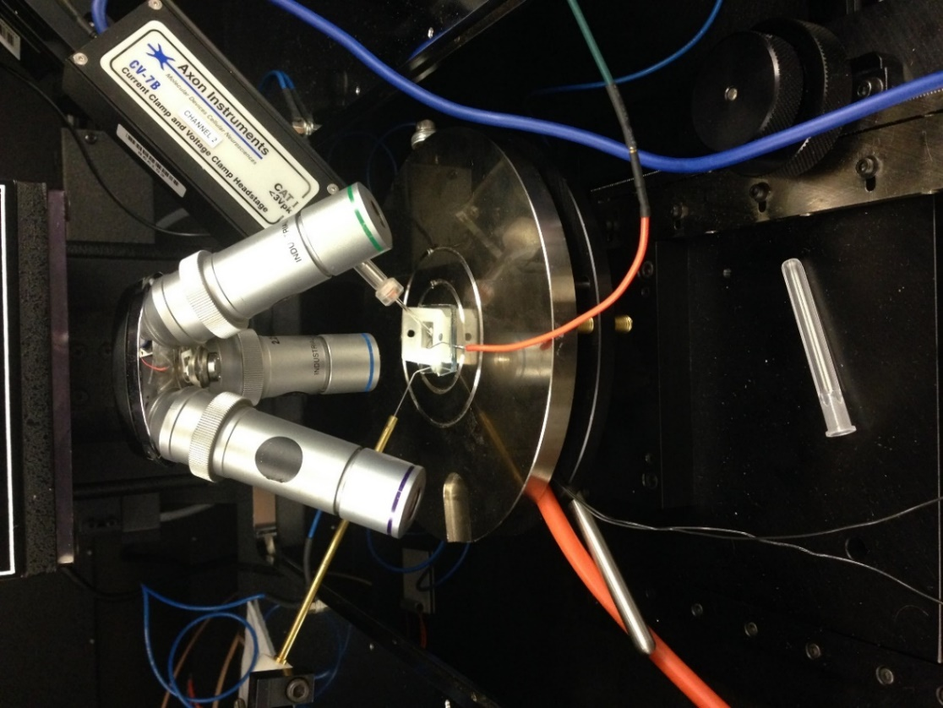
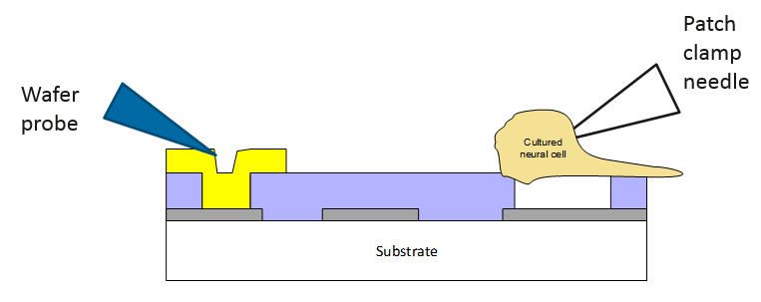
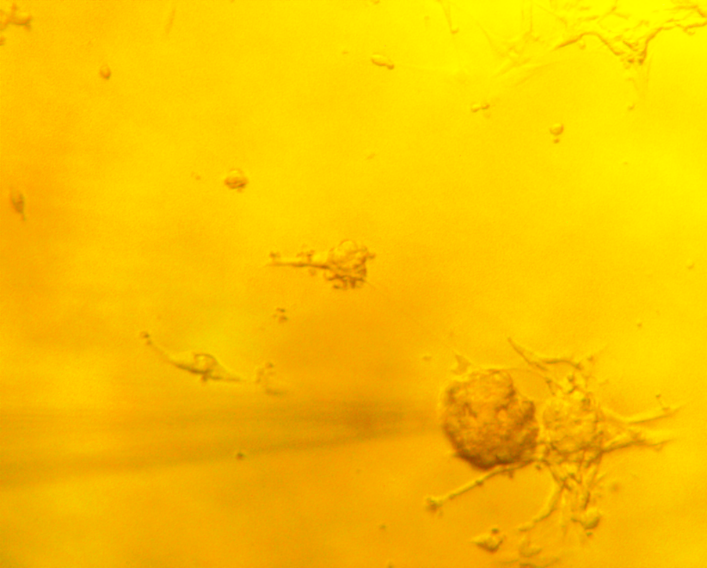
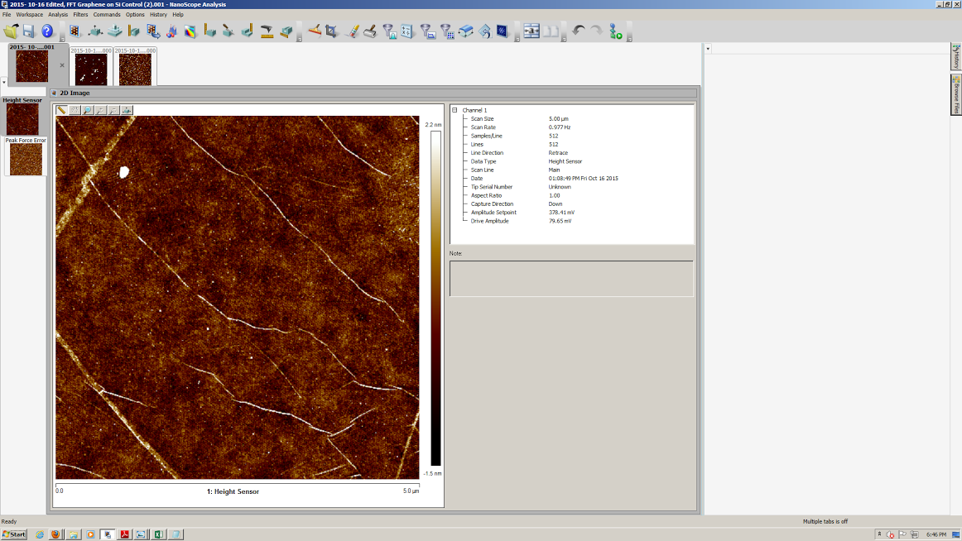
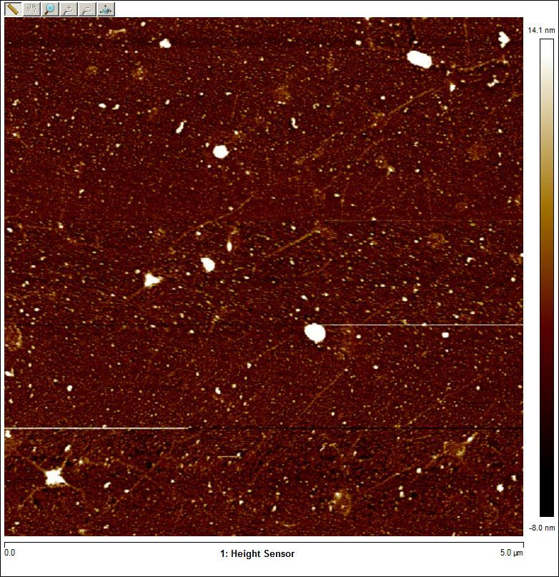
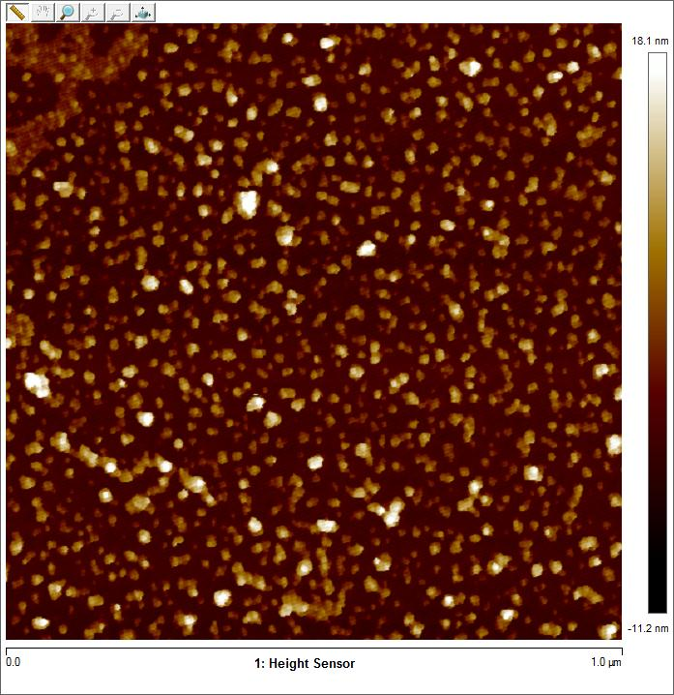
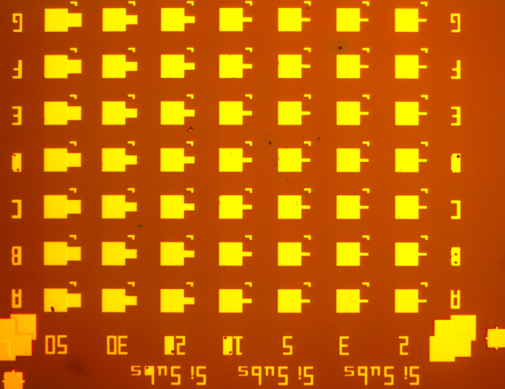
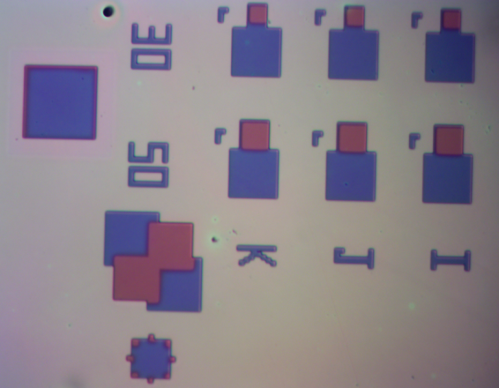



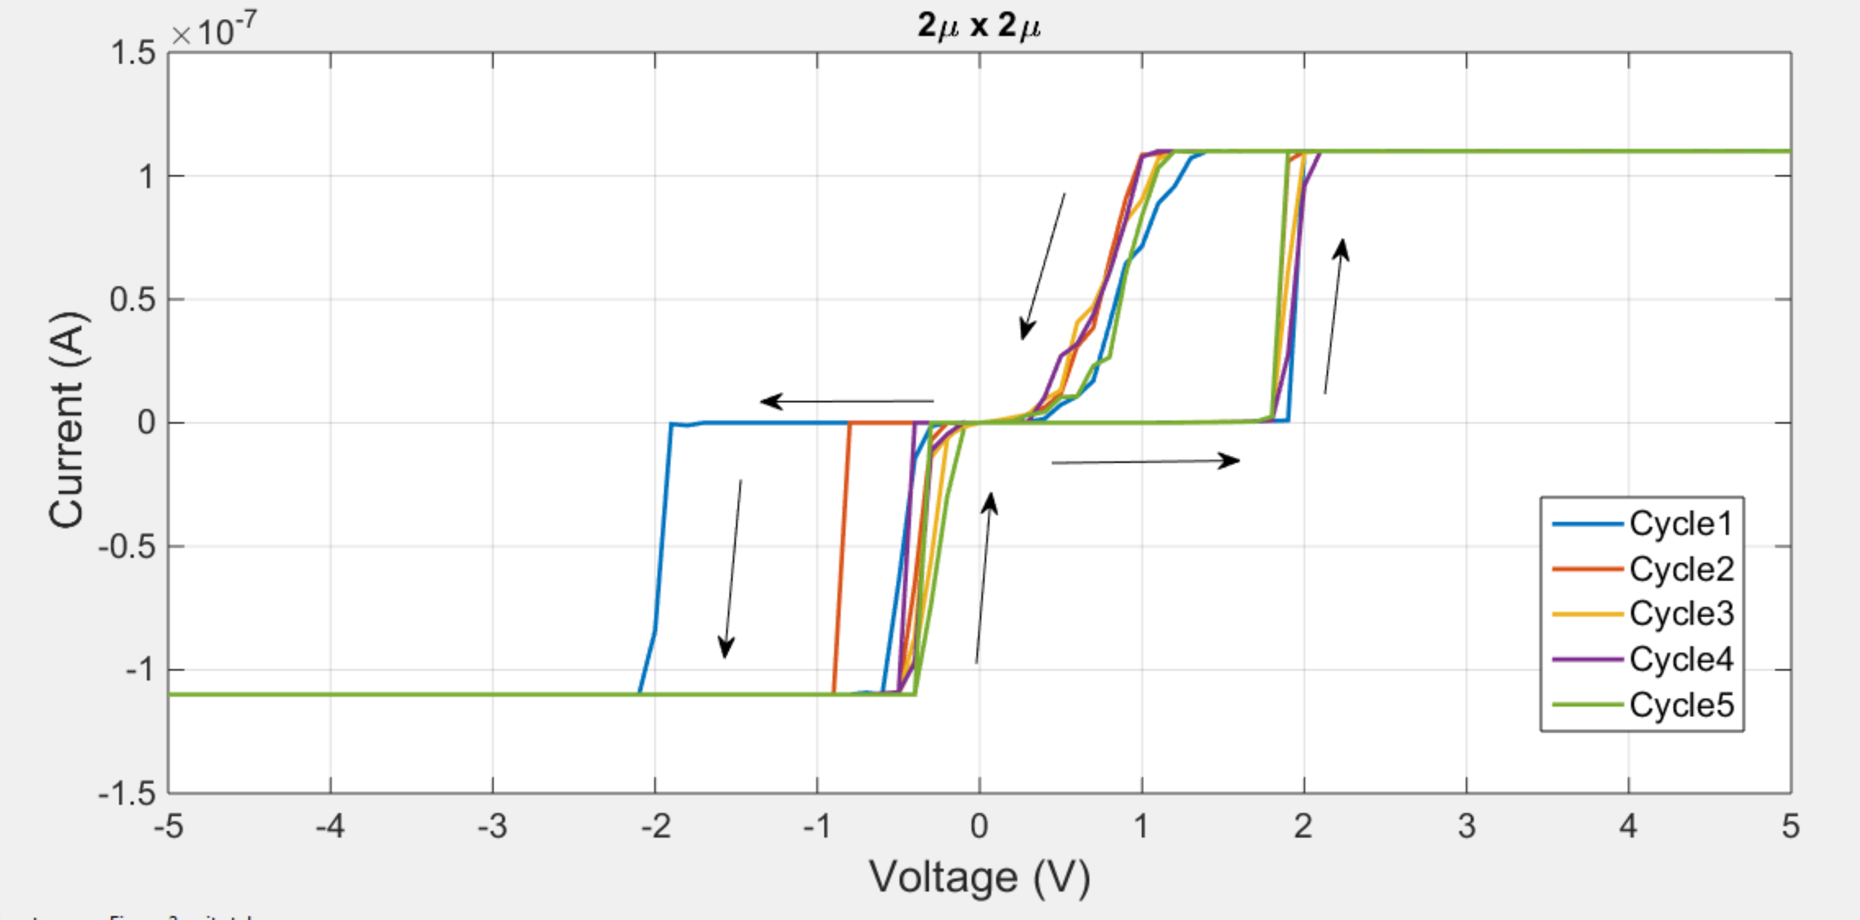

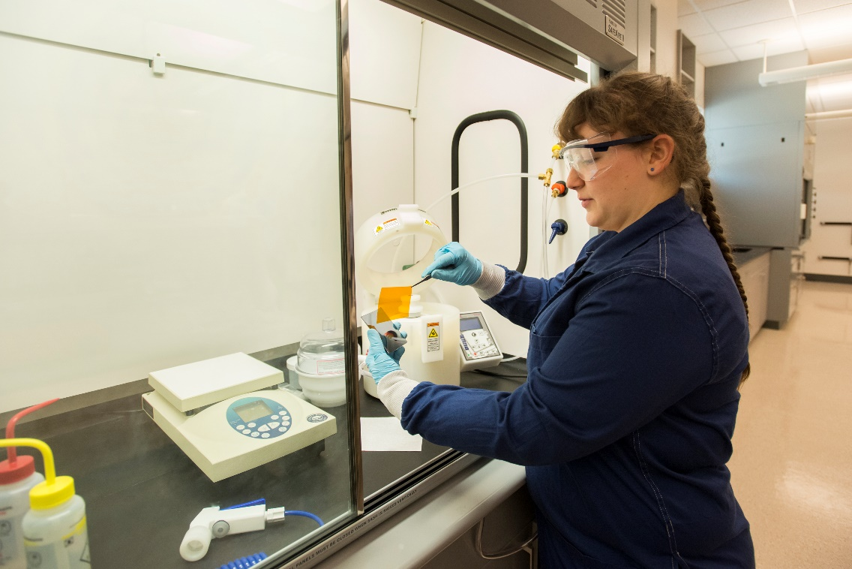
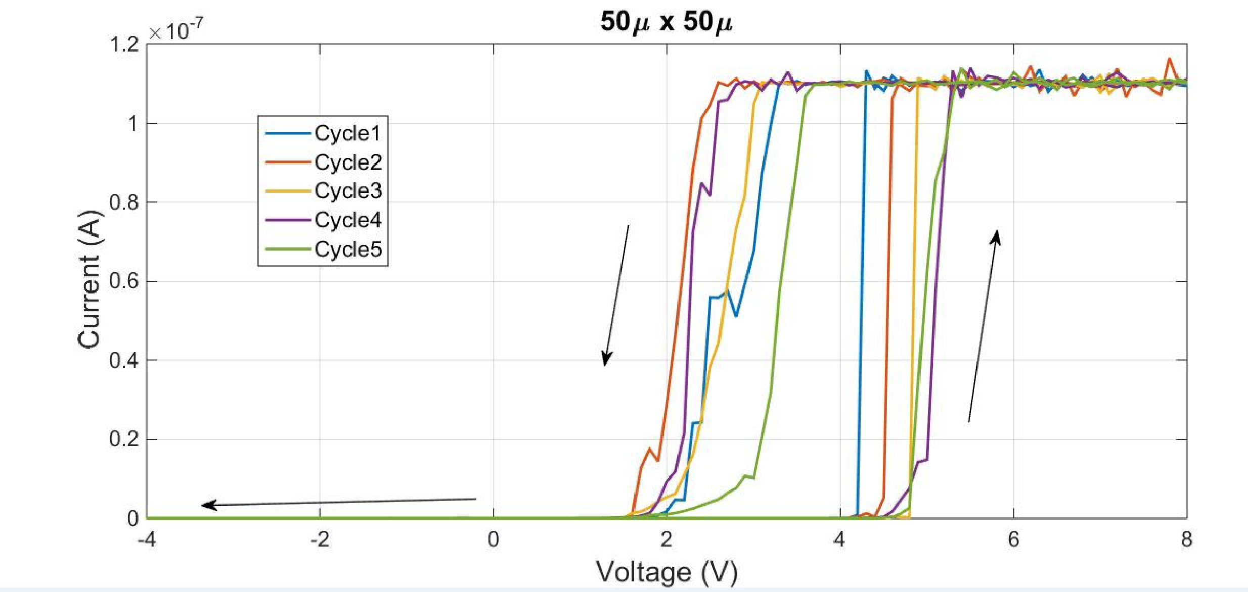
Materials and Devices for Neural Systems and Interfaces
Sumedha Gandharava, Sepideh Rastegar, Catherine Walker, Justin Stadlbauer, Kurtis D. Cantley
Department of Electrical and Computer Engineering, Boise State University
Overview
Thin-Film Transistors (TFTs)
Neural Interfaces
Culturing SH-SY5Y human neuroblastoma cells on graphene-based micro electrode arrays (MEAs)
Electrical characteristics of cells are accessed via patch clamp electrophysiology
Materials
PECVD Nano-crystalline silicon (nc-Si)
Devices
Thin-film transistors for analog, digital, and memory
Circuits
Adaptable artificial neural networks with learning and pattern recognition
Testing
Advanced electrical testing
High-k metal oxides
Metal nanoparticles
Flexible polymers
Memristors
Microelectrode arrays
Digital logic on flexible substrates
Wafer probing
Custom high-performance neural network characterization
Devices utilizing PECVD nano-crystalline silicon deposited at 250 °C or less
Ambipolar operation for complementary circuits
Fig. 4 Neuron Circuit fabricated using optical lithography
(a)
(b)
(c)
[111] peak
[200] peak
[311] peak
Fig. 3 Cross-section and 3-D view of a TFT(Top left and right). Drain current versus gate voltage of a TFT(Bottom left). Input current, voltage of the input capacitor, output voltage and spike frequency of a TFT(Bottom right).
Fig. 7 a) Illustration of neuron cells on active microelectrode sensor arrays. b) Contact pads using Au for graphene arrays. c) Illustration of hexagonal planar graphene structure.
TFT Memories
Fig. 1 Plasma Enhanced Chemical Vapor Deposited (PECVD) nc-Si X-ray diffraction
f
Fig. 8 Probe station constructed (Left), electrophysiology experiment with reservoir-mounted graphene MEA using
SH-SY5Y (human neuroblastoma line) cell (Right and below)
Use nanoparticles to trap charge over millisecond time scales
Used for artificial neural circuits with biologically realistic synaptic learning
Resistive Memory
Two-terminal devices that change resistance based on past current flow (Memristors)
(a)
(b)
(c)
(a)
Nanoparticle memory TFT controls short-term learning
Memristors provide long-term storage of synaptic weights
Fig. 5 a) AFM of CVD graphene. b) AFM of Au nanoparticles on graphene and on SiO₂
Support and Funding
(b)
(d)
Flexible Electronics
Force Office of Scientific Research (AFOSR) Young Investigator Program (YIP), grant FA9550-14-1-0188.
Institutional Development Awards (IDeA) from the National Institute of General Medical Sciences of the National Institutes of Health under Grants #P20GM103408 and P20GM109095.
Boise State Department of Electrical and Computer Engineering.
(e)
Fig. 2
Memristor cross-sections
(a) Metal-Metal contact (b) HfTiO active Layer (c) Metal-Semiconductor contact a-Si based Memristors
(d) Finalized die (e) Vias on die using photolithography method. (f) I-V characteristic of a 2umx2um device
(g) I-V characteristic of a 50umx50um device
Integration of specialized materials and devices onto mechanically flexible substrates
Piezoelectric sensors from PVDF-TrFE copolymer
Fig. 6 a), b), and c) Polymer substrates such as PET, PEN, or polyimide can be bonded to a rigid Si carrier wafer using silicon (PDMS) for simplified processing
(f)
(g)

